Slide 1
eShipGlobal Training Module Reference Guide

Slide 2
UT Dallas Preferred Shipping Service
UT Dallas has secured state contract pricing via eShipGlobal and they are the preferred shipping service for UT Dallas. Using eShipGlobal as your source for all UT Dallas shipments, both domestic and international, will ensure receiving the best discounted pricing available from multiple carriers: FedEx, UPS, and DHL (international only). From eShipGlobal's site, the user can choose the preferred carrier and service, print airbills and return labels from their computer and track packages in transit. Payments are made using the appropriate cost center for your department.
To set up an eShipGlobal shipping account, contact Patrice Holt or Robert Taylor
By email: plm021000@utdallas.edu or rwt091000@utdallas.edu.
Or go to the link below and request access to eShipGlobal.
https://services.utdallas.edu/tools/eshipglobal/
For assistance shipping Hazmat or other hazardous materials, contact:

Slide 3
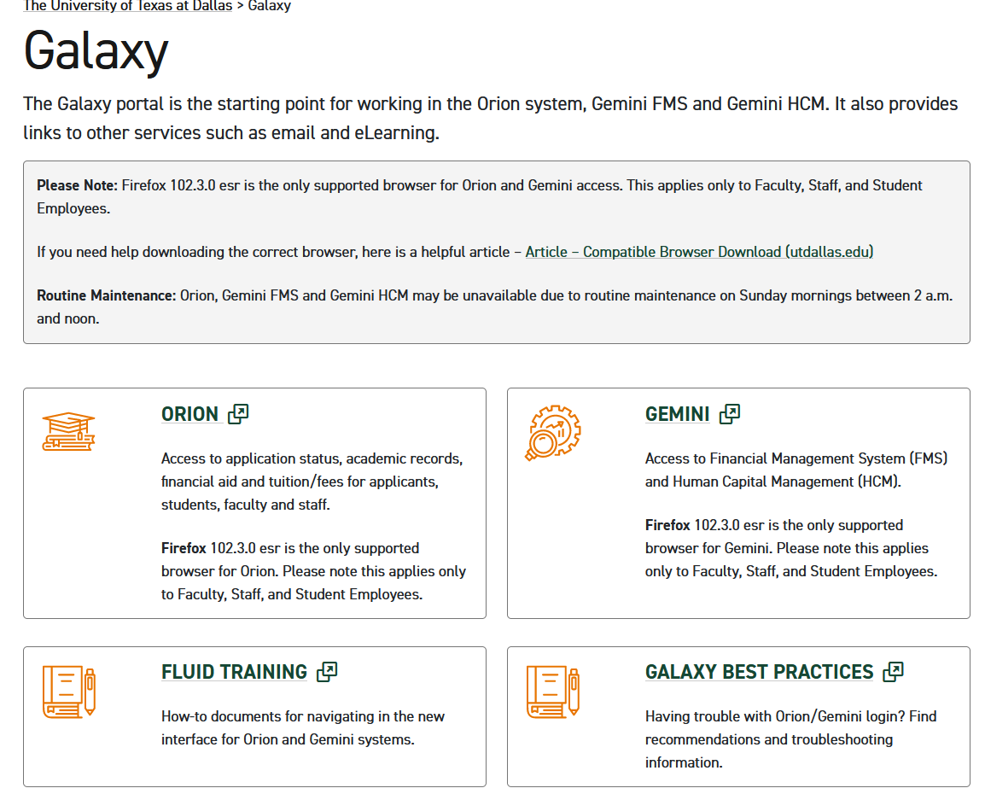
Gaining Access to eShipGlobal
GO TO THE GALAXY LOGIN SCREEN
Click Gemini

Slide 4
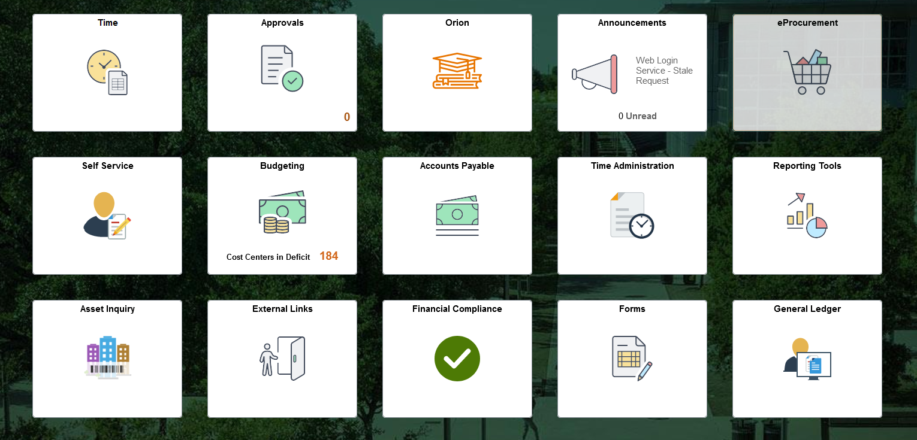
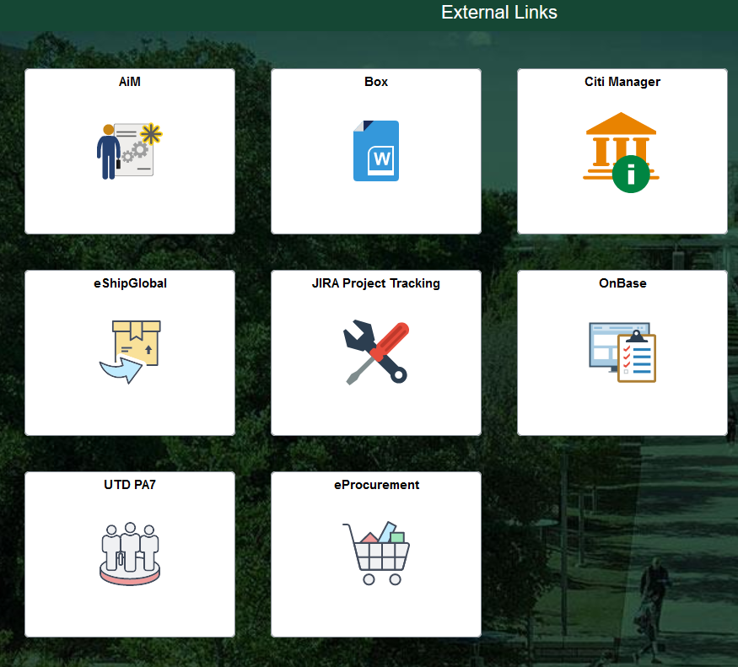
Locating eShipGlobal in Galaxy
Click the eShipGlobal Tab
Click the External Links Tab

Slide 5
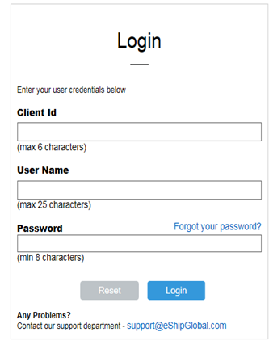
Login to eShipGlobal
The Client Id is
UTDL

Slide 6
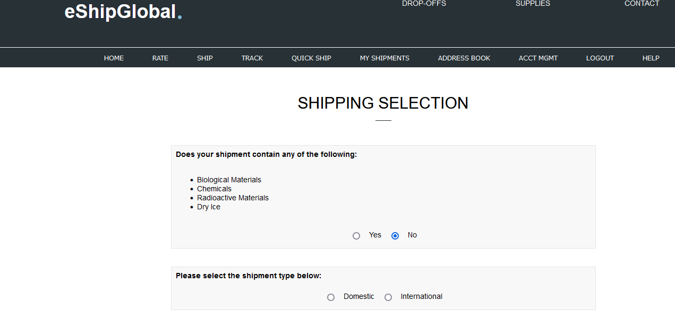
Starting Your Shipment
Click Ship
Then answer the two question below

Slide 7
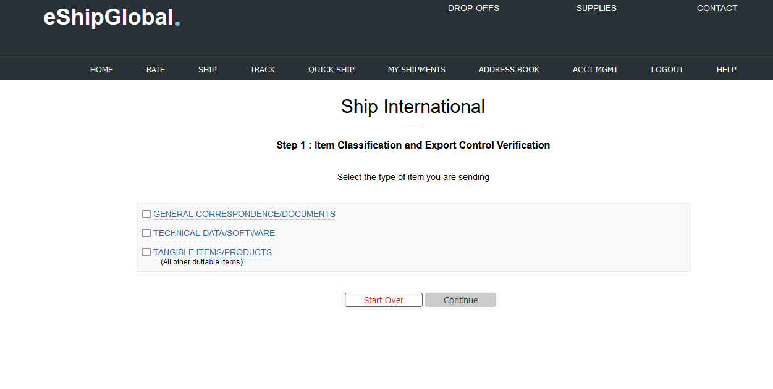
Export Control Verfication
Select one of the following based upon the item you are shipping.

Slide 8
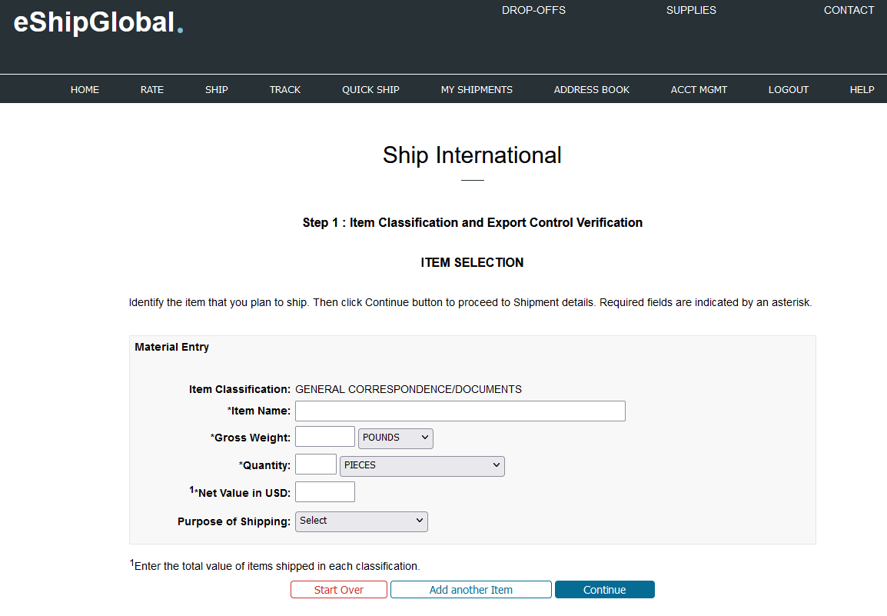
Entering Item Description of Shipment
Enter Item Name, Weight, Quantity, and Value then click continue

Slide 9
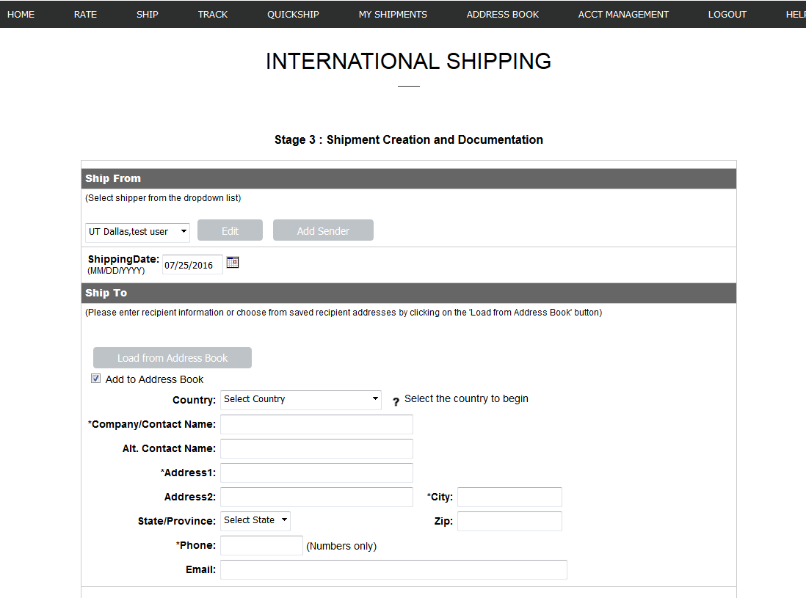
Filling in Shipping Address
Select sender name and address or add new one
Fill in the Recipient’s address

Slide 10
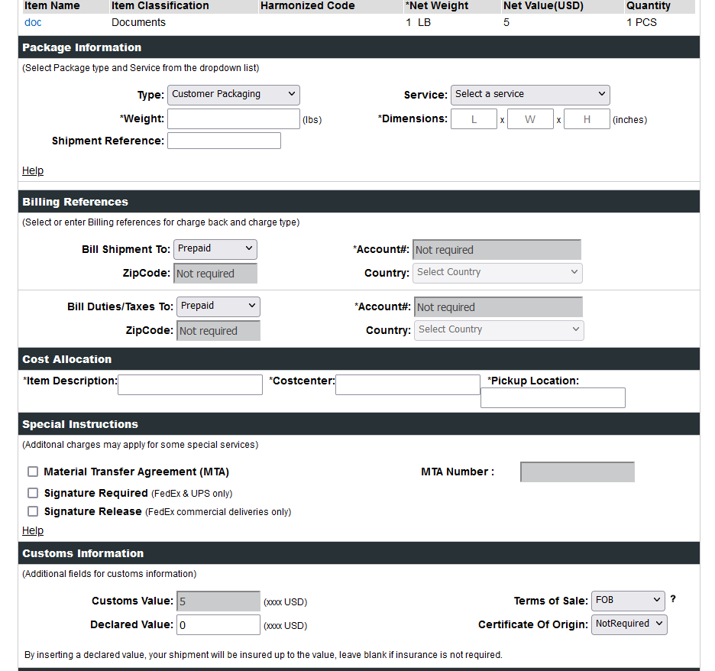
Package Info and Cost Allocation
Select package type from the pulldown menu, give weight and dimensions of shipment.
Fill in Item Description, Cost Center and Pickup Location and then Click on Show Quote

Slide 11
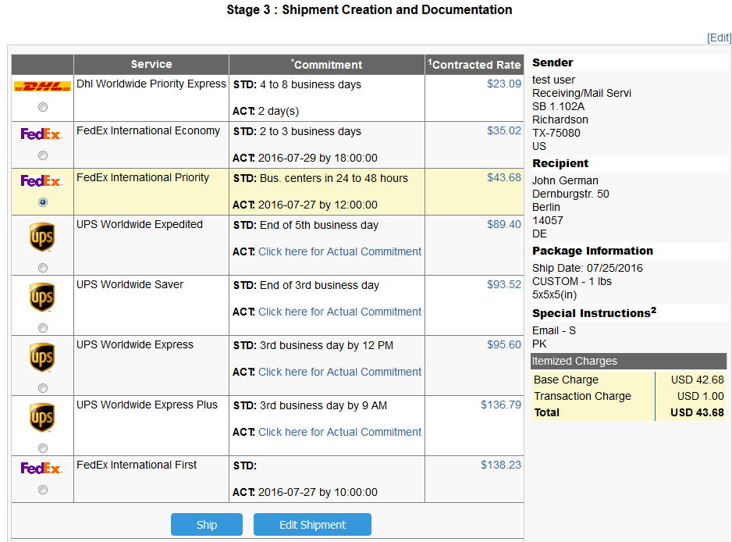
Carrier Quotes
Select Carrier option and then click on the Ship button at the bottom of the screen.

Slide 12
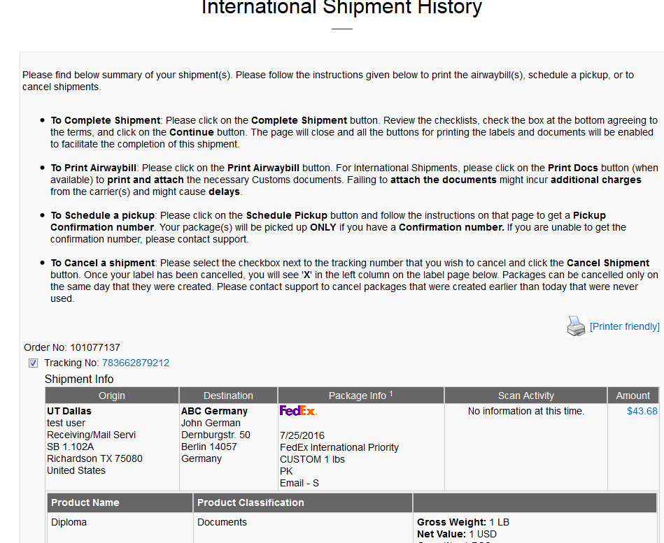
Complete Shipment Process
Click on Complete Shipment. The next step is a Compliance Checklist.

Slide 13
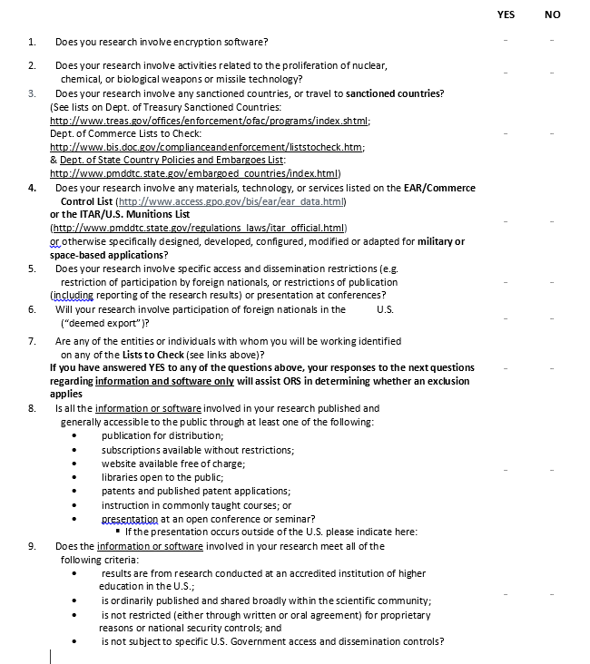
Checklist for Export Control
This Checklist will provide time/date stamp and allows the user to acknowledge items they are shipping.
By checking this box you certify that you understand and will comply with all applicable export control laws and regulations
Continue

Slide 14
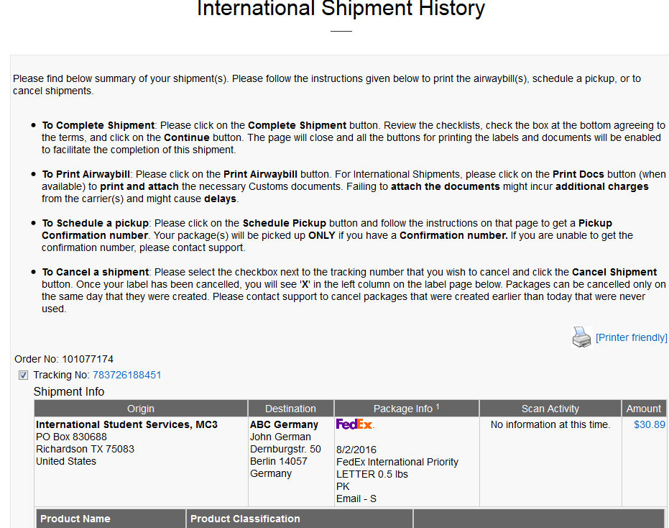
Printing Airway Bills & Supporting Documents
After the Export Checklist, the user will now be able to print Airway bills and supporting documents.

Slide 15
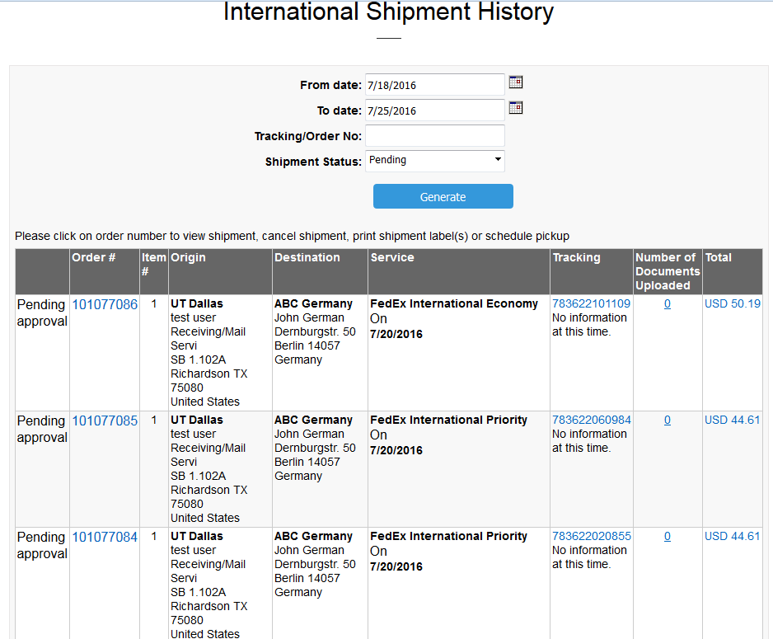
User View of Current and Previous Shipments
Shipment History will display a list of individual user shipments as well as status of each shipment.

Slide 16
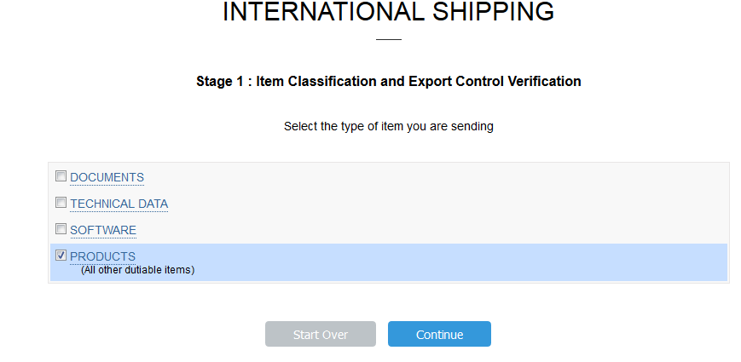
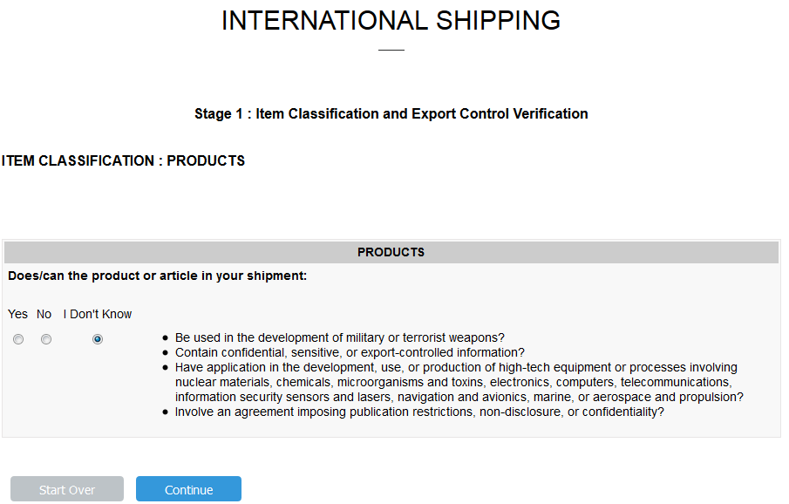
Item Classification Review
In this example, Product was selected to show the additional US Compliance codes.

Slide 17
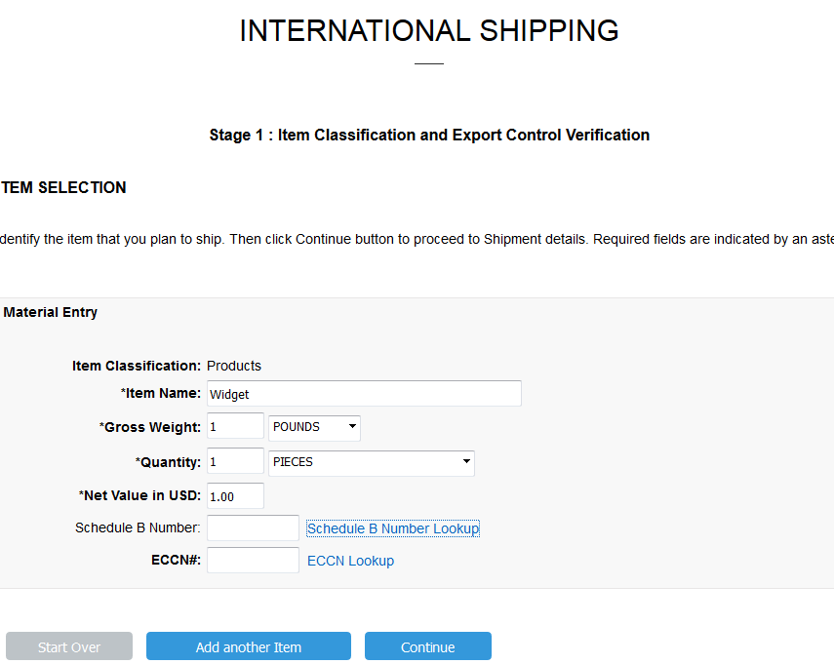
Schedule B Lookup
Schedule B Number Lookup allows user to describe product being shipped in order to get the correct number the US Census Bureau gives each item on the Foreign Trade Schedule. If not known, an ECO (Export Control Officer) is able to fill this in.
ECCN (Export Control Classification Number) Lookup is only for the ECO of the system.

Slide 18
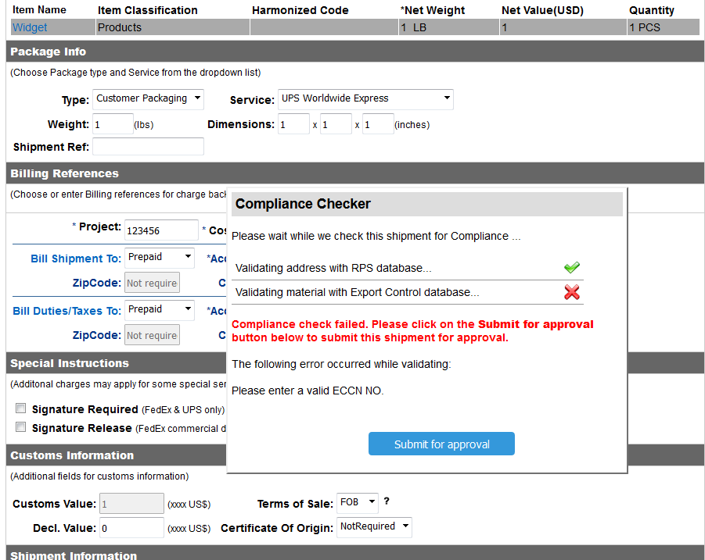
Export Control Compliance Check Fail
Compliance checked failed.
User can go no further without approval from ECO. An email is sent immediately to ECO to alert a shipment is pending.

Slide 19
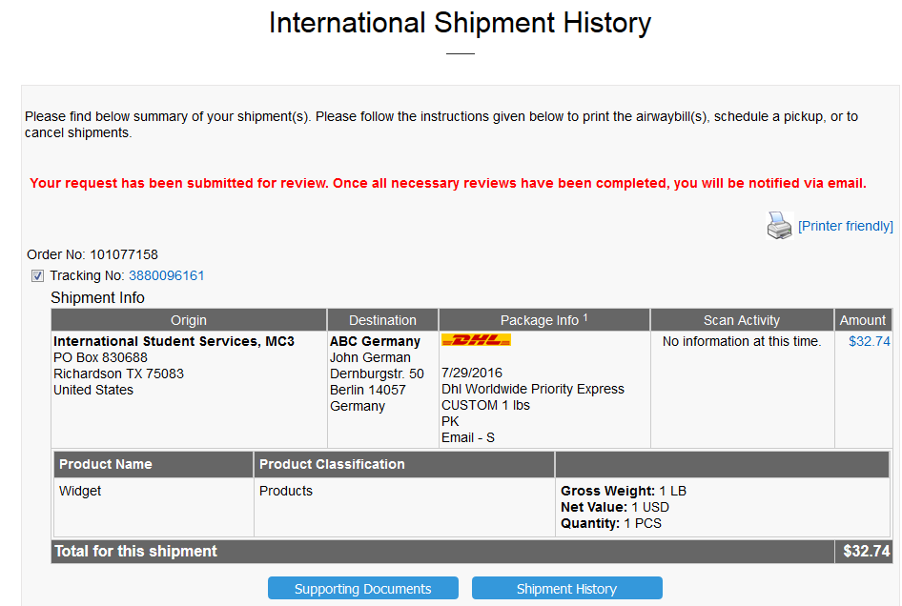
Notification to User Regarding ECO Approval

Slide 20
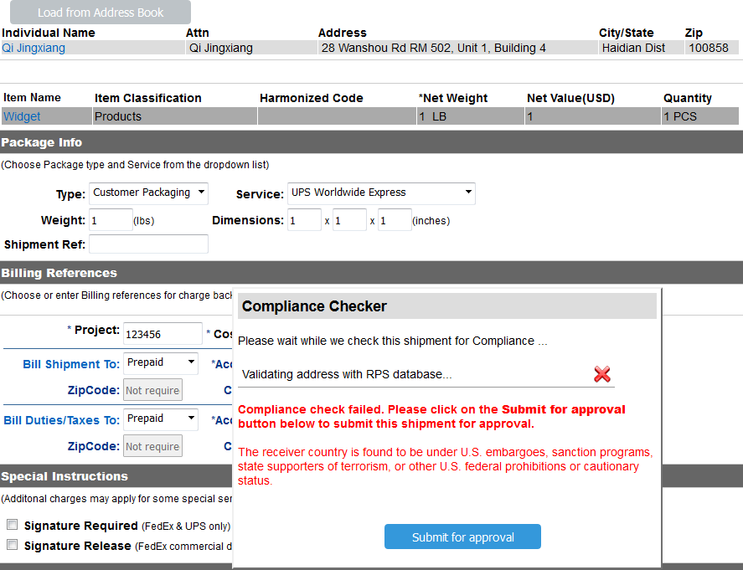
Explanation of Compliance Fail
Shipment denied due to Embargoed country. Sent to ECO for approval.

Slide 21
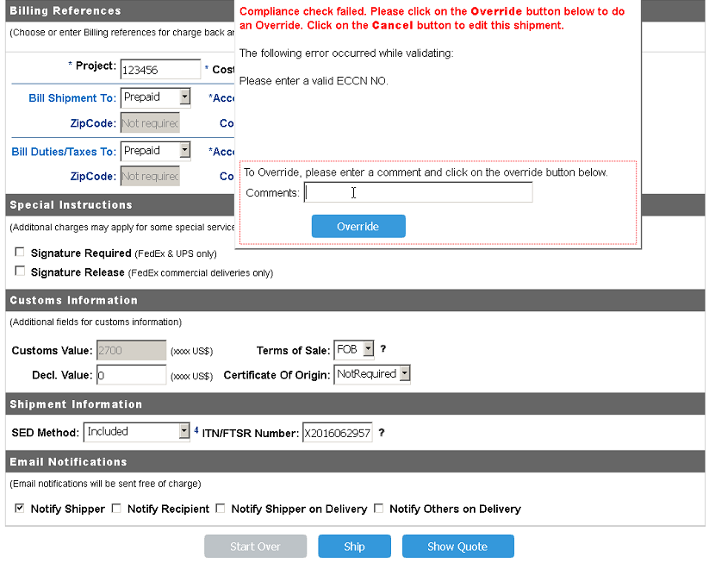
ECO Override
ECO Admin override needed.
User will be notified via email regarding status and be able to complete the shipment.

Slide 22
eShipGlobal Questions?
For general shipping questions contact:
Robert Taylor at rwt091000@utdallas.edu
For assistance shipping Hazmat or other hazardous materials, contact: DG-Ship@utdallas.edu with the Department of Research.

